Slide 1


Oracle database
Lecture 16

Slide 2

Today’s Agenda
Introduction To GROUP BY Clause
Using WHERE With GROUP BY
Using HAVING With GROUP BY
WHERE vs HAVING

Slide 3
The GROUP BY Clause
The GROUP BY clause is used in a SELECT statement to group rows into a set of summary rows by values of columns or expressions.
The GROUP BY clause then returns one row per group.

Slide 4
The GROUP BY Clause
The GROUP BY clause is often used with aggregate functions such as AVG(), COUNT(), MAX(), MIN() and SUM().
In this case, the aggregate function returns the summary information per group.

Slide 5
The GROUP BY Clause
For example, suppose in the EMP table we want to find number of employees in each department.
Then in this case , we will ask Oracle to group the rows of the table based upon the department no and then apply the function COUNT() on each group.
In this way , the COUNT() function will return the number of employees in each group.

Slide 6
Syntax Of GROUP BY
Syntax:
SELECT column_list
FROM <table_name>
GROUP BY <col_name>;
Points To Remember:
GROUP BY always appears after FROM clause if WHERE is not present.
If WHERE is present , the GROUP BY appears after WHERE.
Only GROUP FUNCTIONS or the column on which GROUP BY is applied can appear in SELECT command

Slide 7
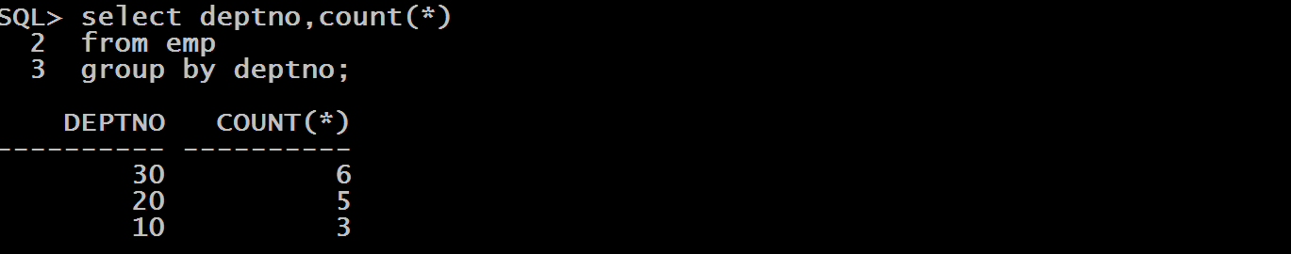
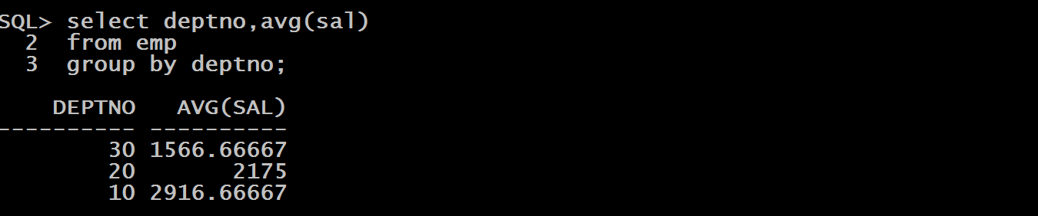
Queries
WAQ to display number of employees in each department.
WAQ to display average salary of each department

Slide 8
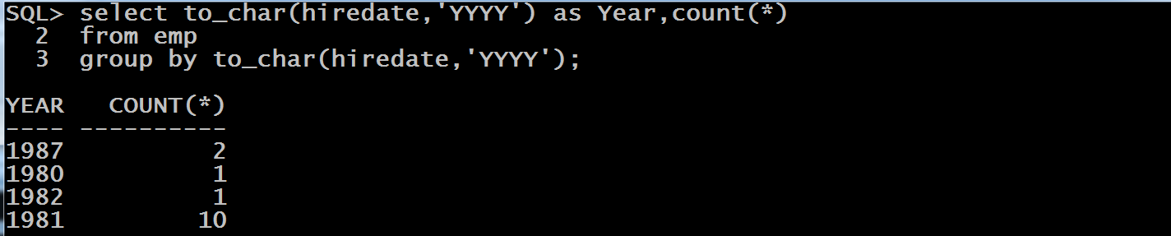
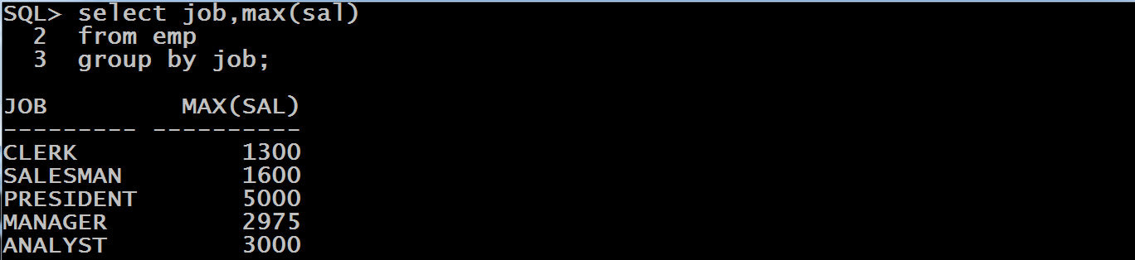
Queries
WAQ to display number of employees hired every year.
WAQ to display max salary of each job

Slide 9

Guess The Output ?
Select hiredate,count(*)
Form emp
Group by to_char(hiredate,’YYYY’);
Answer:
REASON: We can only use those expressions in SELECT on which GROUP BY has been done. In the above query GROUP BY is done on YEAR so we cannot display HIREDATE

Slide 10
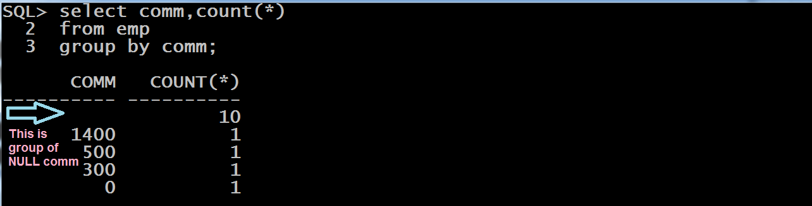
GROUP BY And NULL
When we GROUP BY a column that contains NULL values for some rows, all the rows with NULL values are placed into a single group and presented as one summary row in the output.
For Example:
Select Comm, Count(*)
From emp
Group by Comm;

Slide 11
Can We Remove NULL ?
Yes, we can remove NULL from being grouped by using WHERE clause in the QUERY.
While executing an SQL statement with a WHERE clause and a GROUP BY clause, Oracle first applies the WHERE clause and filters out the rows that don’t satisfy the WHERE condition.
Then , the rows that satisfy the WHERE clause are then grouped using the GROUP BY clause.

Slide 12
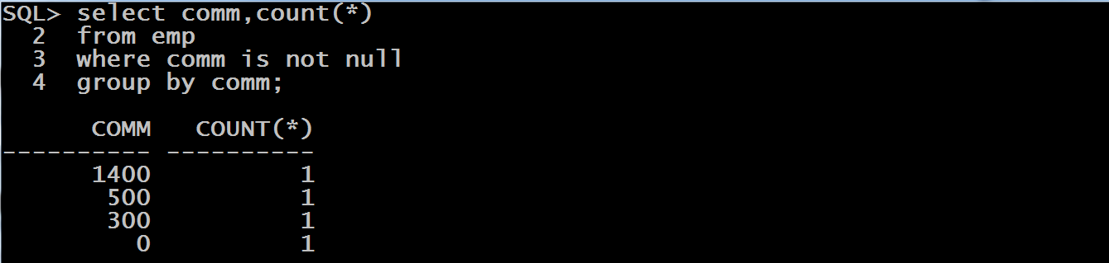
Can We Remove NULL ?

Slide 13
Filtering Results Of Group By
To filter the results of GROUP BY , we can use HAVING clause.
The purpose of the HAVING clause is to eliminate groups, just as the WHERE clause is used to eliminate rows.
If a query has a HAVING clause along with a GROUP BY clause, the result set will include only the groups that satisfy the condition specified in the HAVING clause.

Slide 14
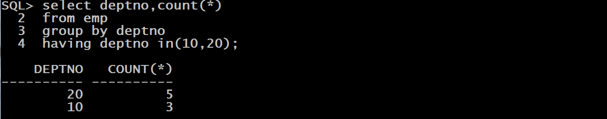
Filtering Results Of Group By
For example , suppose we want to find the number of employees in each department but want to consider only departments 10 and 20.
In this case the query will be
Select deptno,count(*)
From emp
Group by deptno
Having deptno in(10,20);

Slide 15
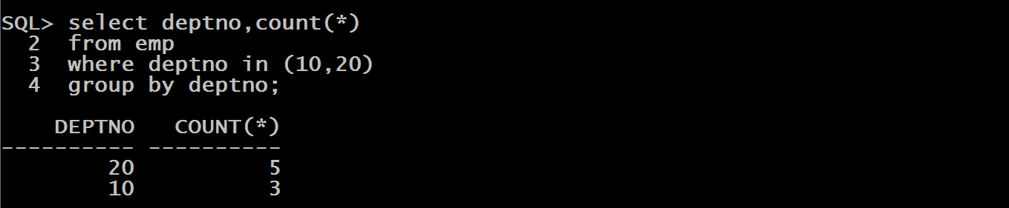
If WHERE Is There , Then Why HAVING ?
Now looking at the above query you might think that this can be easily done with WHERE also, which is absolutely true.
And this raises the question why to use HAVING , when we have WHERE

Slide 16
WHERE vs HAVING
WHERE can only be used to filter on the basis of scalar values and not on the basis of group functions .
For example , suppose we want to find the number of employees in each department but want to consider only those departments where number of employees working is more than 3 .

Slide 17
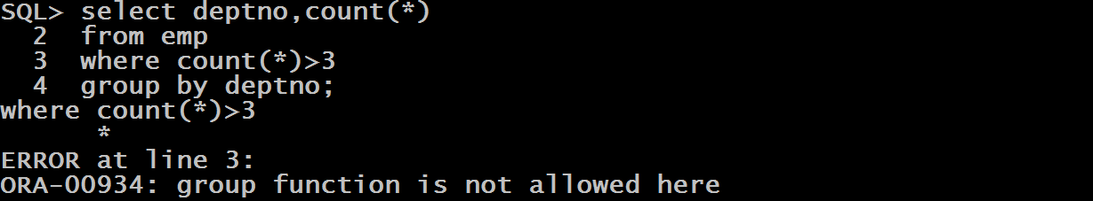
WHERE vs HAVING
Now we cannot use WHERE in this case because WHERE does not allow using GROUP FUNCTIONS as the results of the aggregate function cannot be determined until after the grouping takes place.

Slide 18
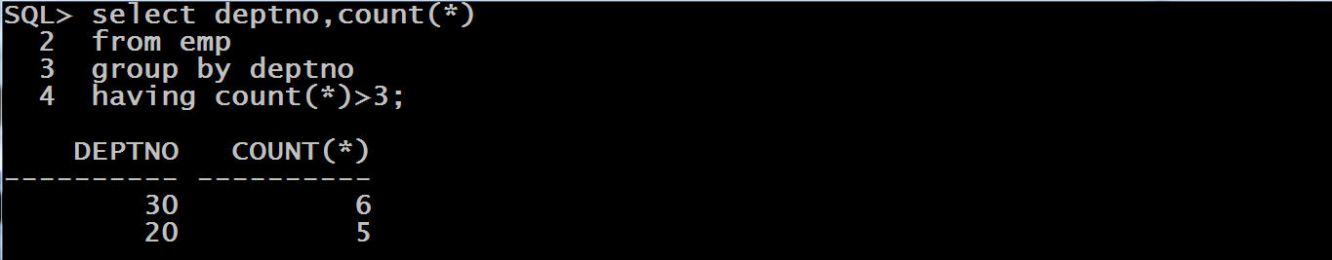
WHERE vs HAVING
However the same query can be easily done using HAVING

Slide 19
WHERE vs HAVING
But HAVING also has a restriction , which is that:
If HAVING filters on the basis SCALAR VALUE then the column being used must be a part of GROUP BY. For example if GROUPING has been done on the basis of DEPTNO then we cannot filter on the basis of HIREDATE as a single value expression
If HAVING filters on the basis of GROUP FUNCTION , then the column used may or may not be a part of GROUP BY

Slide 20

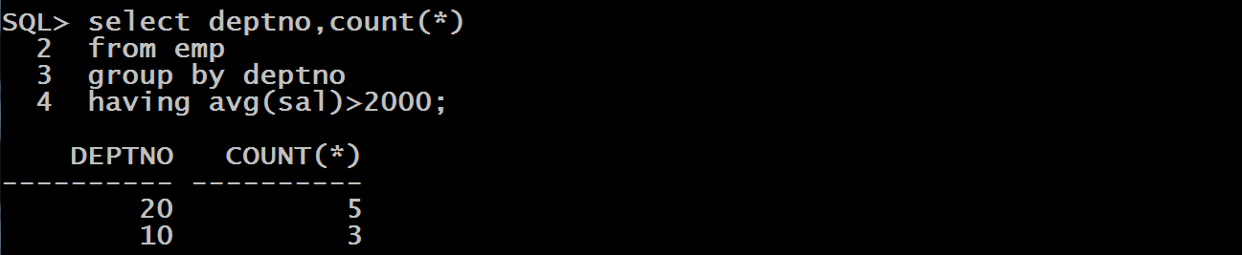
WHERE vs HAVING

Slide 21
Can We Use Both WHERE And HAVING Together ?
Yes, it is possible to use both WHERE and HAVING in the same query and this sometimes becomes essential too.
This happens when we want to filter both on the basis of SCALAR VALUE as well as on the basis of a GROUP FUNCTION result.

Slide 22
Can We Use Both WHERE And HAVING Together ?
Now , when we do this:
The WHERE clause is executed first, and the rows that don’t satisfy the WHERE condition are not passed to the GROUP BY clause.
The GROUP BY clause summarizes the filtered data into groups, and then the HAVING clause is applied to the groups to eliminate the groups that don’t satisfy the HAVING condition.

Slide 23

Can We Use Both WHERE And HAVING Together ?
WAQ to display no of employees in each department who get a comm and where the MINIMUM sal is greater than 1000

Slide 24
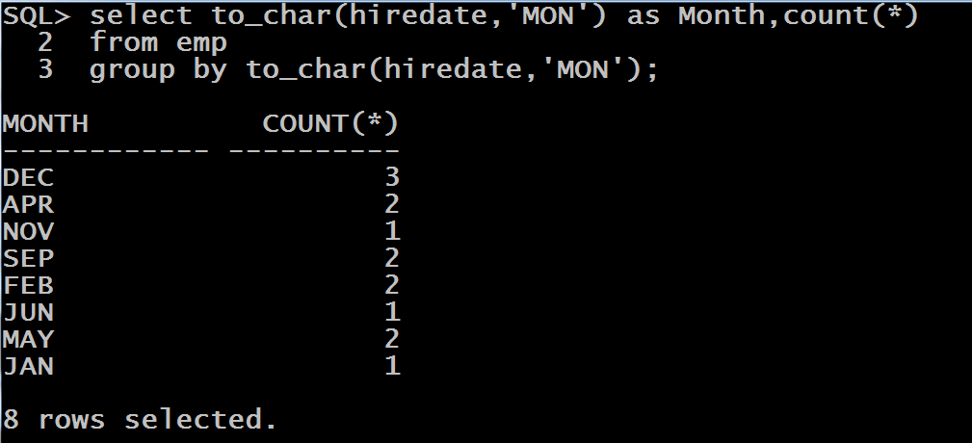
Queries
WAQ to display number of employees hired every month

Slide 25
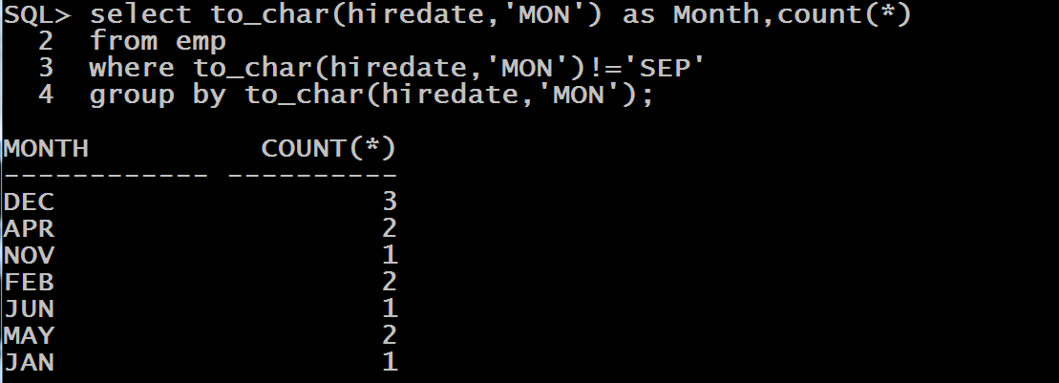
Queries
Modify the previous query so that the output doesn’t contain the month of APRIL.

Slide 26
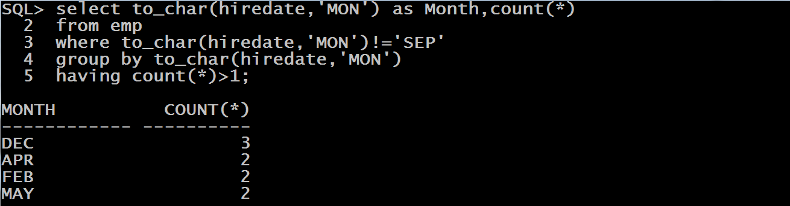
Queries
Further modify the previous query so that the output doesn’t contain those months where employee count hired is less than 2.

